Slide 1

Measurement of force torque and pressure

Slide 2
Measuring devices
Measurands | Measuring instruments
Force, load | Analytical balance
 | Platform balance
 | Proving ring
Torque | Prony brake
 | Hydraulic dynamometer
Pressure | Bridgeman gauge
 | Mcload gauge
 | Pirani gauge

Slide 3
Introduction
Force: It is defined as the reaction between the two bodies or components.
The reaction can be either tensile force (Pull) or it can be Compressive force (Push).
Measurement of force can be done by any two methods:
Direct Method: This involves a direct comparison with a known gravitational force on a standard mass. Example: Physical Balance.
Indirect Method: This involves the measurement of effect of force on a body. E.g. Force is calculated from acceleration due to gravity and the mass of the component.

Slide 4
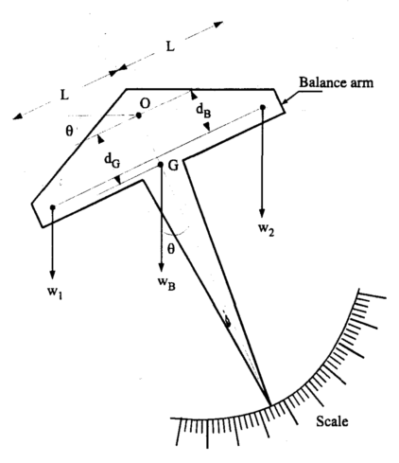
Direct Method: Analytical Balance (Equal arm balance)

Slide 5
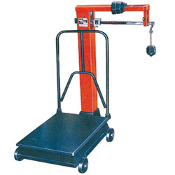
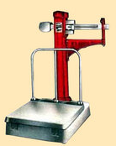
Unequal arm balance:

Slide 6
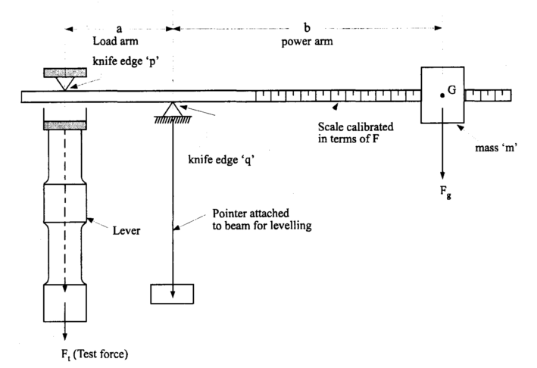
Unequal arm balance:

Slide 7
Unequal arm balance:
For balance of moments,
F_{t} * a = F_{g} * b
or test force,
F_{t} = F_{g} * (b / a)
Therefore, the test force is proportional to the distance ‘b’ of the mass from the pivot.

Slide 8
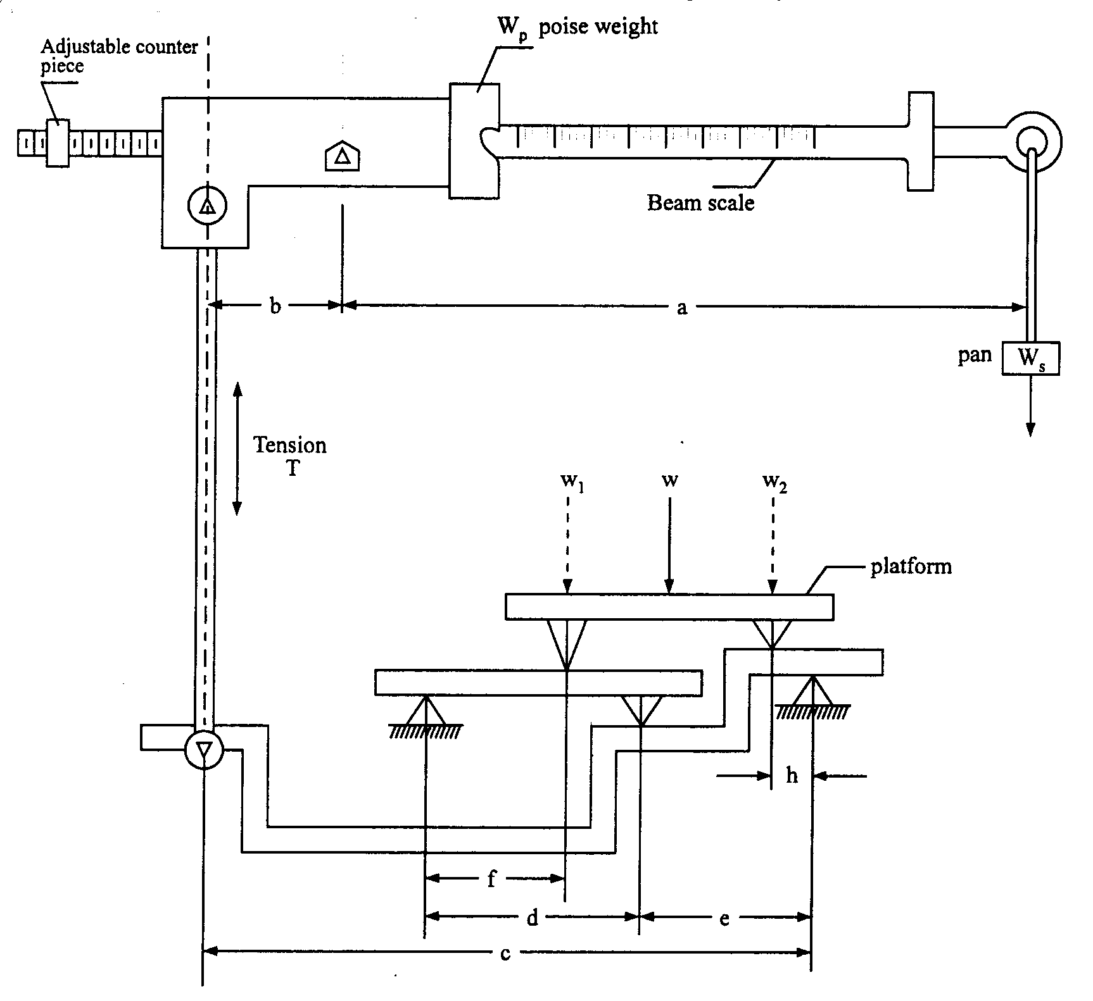
Platform Balance: (Multiple Lever System)

Slide 9


Platform Balance: (Multiple Lever System)
Large weight W may be measured in terms of smaller weights Wp and Ws.
Weight Wp is called the poise weight and Ws the pan weight.
The weight W1 and W2 is may be substituted for W.
With W on the scale platform and balanced by a pan weight Ws, the relation is given by
T*b = Ws * a (1)
T*c = W1 (f/d) e + W2 * h (2)
Now if we proportion the linkage such the

Slide 10
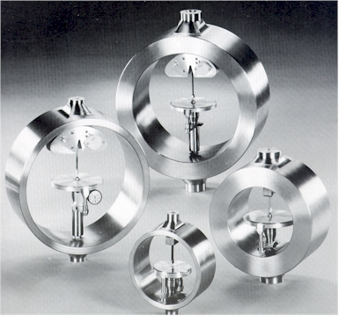
Proving ring
The proving ring is a device used to measure force. It consists of an elastic ring of known diameter with a measuring device located in the center of the ring.
They are made of a steel alloy.
manufactured according to design specifications established in 1946 by the National Bureau of Standards (NBS).
Proving rings can be designed to measure either compression or tension forces.

Slide 11

Proving ring
Standard for calibrating material testing machine.
Capacity 1000 N to 1000 kN.
Deflection is used as the measure of applied load.
This deflection is measured by a precision micrometer.
Micrometer is set with a help of vibrating reed.
P = force or load
M = Bending moment
R = Radius of proving ring

Slide 12
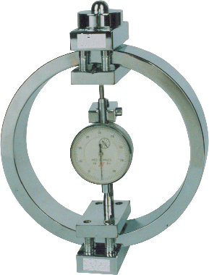
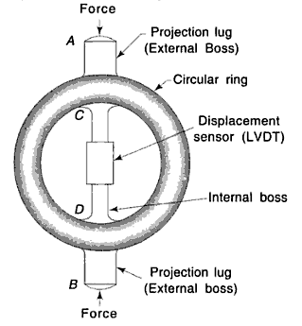
Proving Ring:
A ring used for calibrating tensile testing machines. It works on the principle of LVDT which senses the displacement caused by the force resulting in a proportional voltage.
It is provided with the projection lugs for loading. An LVDT is attached with the integral internal bosses C and D for sensing the displacement caused by application of force.
When the forces are applied through the integral external bosses A and B, the diameter of ring changes depending upon the application which is known as ring deflection.

Slide 13
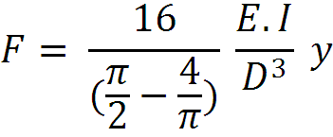
Proving Ring:
The resulting deflection of the ring is measured by LVDT which converts the ring deflection or displacement in to voltage signal.
An external amplifier may be connected to provide direct current to drive the indicators or the measured value of force.
In place of LVDT micrometer can also be provided for accurate measurement of force or deflection, which is given by formula
Where,
F is the force, E is the young's modulus, I is the moment of inertia about the centroidal axis, D is the outer diameter of the ring and y is the deflection.

Slide 14
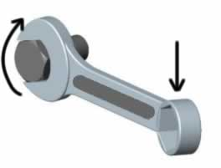
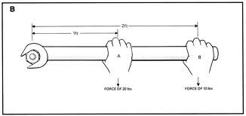
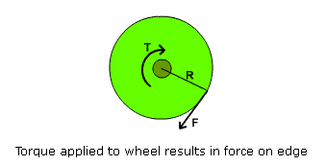

Torque Measurement:
Torque: Force that causes twisting or turning moment.
E.g. the force generated by an internal-combustion engine to turn a vehicle's drive or shaft.
Torque measuring devices are called as dynamometers.
The torque may be computed by measuring the force ‘F’ at a known radius ‘r’, given by the formula
in N - m

Slide 15
Torque Measurement:
Torque measurement is usually associated with determination of mechanical power, either power required to operate a machine or to find out the power developed by the machine.
Where,
N = Speed in rpm.
T =Torque developed due to load “W”, (N-m)
R = Radius from the center to the point of application of force (m)

Slide 16
Types of Dynamometers:
Absorption dynamometers:
They are useful for measuring power or torque developed by power source such as engines or electric motors.
Driving dynamometers:
These dynamometers measure power or torque and as well provide energy to operate the device to be tested.
These are useful in determining performance characteristics of devices such as pumps and compression.
Transmission dynamometers:
These are the passive devices placed at an appropriate location within a machine or in between the machine to sense the torque at that location.

Slide 17
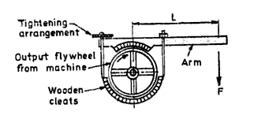
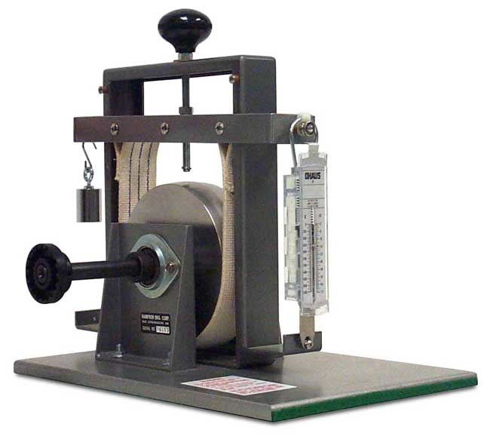
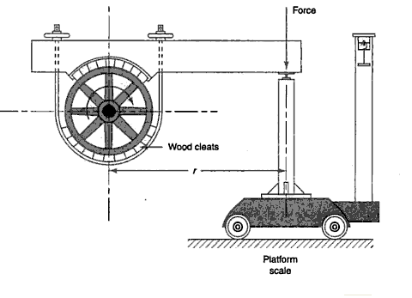
Mechanical Dynamometer (Prony Brake):
Rope

Slide 18
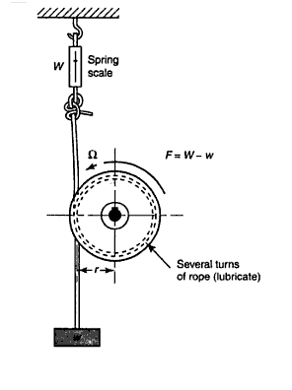
Consists of wooden cleats or blocks mounted diametrically opposite on a flywheel attached to the rotating shaft whose power is to be determined.
One wooden block carries a lever arm and an arrangement is made to tighten the rope to increase the frictional resistance between the blocks.
The torque exerted by the Prony brake is T = F . L

Slide 19
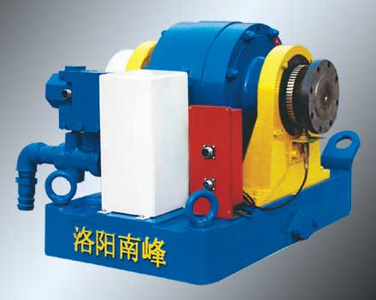
Hydraulic Dynamometer:
This is a power sink which uses fluid friction for dissipation of the input energy and there by measures the input torque or power.
The capacity of hydraulic dynamometer is a function of two parameters speed and the water level.
The torque is measured with the help of reaction arm or shaft.
The power absorption at a given speed may be controlled by adjustment of water level in the housing.

Slide 20
This dynamometer may be used in larger capacities than the simple Prony brake dynamometer because heat generated can be can be easily removed by circulating the water in and out of the housing.
The force acting on the shaft is then measured by using the force measuring device or strain gauges.
Then by using the relation, T = F . r, we can find the torque acting on it.

Slide 21
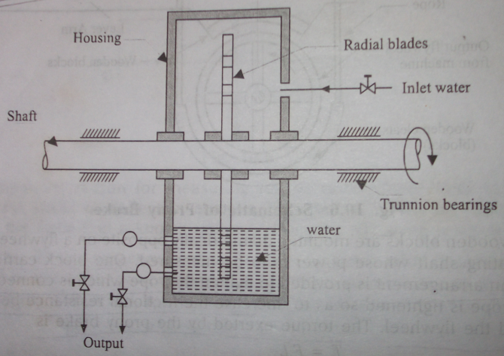
Hydraulic Dynamometer:

Slide 22
Hydraulic Dynamometer Characters
Small in size. Easy installation
Simple dynamometer structure and easy for maintenance
High brake torque
High measurement accuracy
Reliable and stable working condition
High real-time speed measurement accuracy with EM sensors
Fast loading control by electronic-control butterfly valve
High reaction speed which is suitable on dynamic testing Tuning of in-use engines, typically at service centers or for racing applications

